Slide 1

CONTINUATION OF CARE
ICEMA POLICY #9010

Slide 2
PURPOSE
To ensure the rapid transport of patients that require urgent transfer for higher level care at a Specialty Care Center.
Notes:
This policy is not to be used for inter-facility transfer of patients.

Slide 3
ICEMA Continuation of Care Policy
Shall be used by:
EMS Providers - to pit stop and stabilize
Referral Hospital - to provide rapid assessment stabilization & transfer of STEMI, stroke and trauma patients to an appropriate Specialty Care Center
Specialty Care Centers - For the automatic acceptance of Trauma, STEMI, & Stroke Patients
Notes:
This policy includes the rapid transfer from specialty care center to specialty care center when higher level of care is required.

Slide 4
DEFINITIONS
4. Specialty Care Center
ICEMA designated Trauma, STEMI, Stroke Center
5. Referral Hospital
Any licensed general acute care hospital that is not an ICEMA designated Trauma, STEMI, or Stroke Center.
Notes:
Utilized by a referral hospital because specialty care services are not available at the referral hospital.

Slide 5
DEFINITIONS
Trauma Center
A licensed general acute care hospital designated by ICEMA as a trauma receiving center
Level I-Level IV
2. STEMI receiving Centers
A licensed general acute care hospital designated by ICEMA as a STEMI receiving center
emergency interventional cardiac catheterization capabilities
3. Stroke Receiving Center
A licensed acute care hospital designated by ICEMA as a Stroke receiging center
Acute Ready, Primary, Thrombectomy Capable or Comprehensive stroke Center.

Slide 6
TRAUMA RECEIVING CENTERS
Arrowhead Regional Medical Center-Level I
Loma Linda University Medical Center-Level I
Loma Linda University Children’s Hospital-Level I
Pomona Valley Hospital Medical Center-Level II (LA County)
Desert Regional Medical Center-Level II (Riverside County)
Hi-Desert Medical Center-Level IV

Slide 7
STEMI RECEIVING CENTERS
Desert Valley Hospital
Loma Linda University Medical Center
Pomona Valley Hospital Medical Center (LA County)
San Antonio Community Hospital
St. Bernadine’s Medical Center
St. Mary Medical Center
Notes:
Note that STEMI center can be a trauma referral hospital etc

Slide 8
STROKE RECEIVING CENTERS
Redlands Community Hospital - Thrombectomy Capable
Loma Linda University Medical Center - Comprehensive
Arrowhead Regional Medical Center - Comprehensive
San Antonio Community Hospital - Primary
Pomona Valley Hospital Medical Center - Comprehensive (LA County)
Desert Regional Medical Center - Comprehensive (Riverside Co)
Kaiser Fontana - Primary
Kaiser Ontario - Primary
St Mary Medical Center - Primary
St Bernardine Medical Center - Primary
Hi-Desert Medical Center - Acute Ready
Notes:
Note that STEMI center can be a trauma referral hospital etc

Slide 9
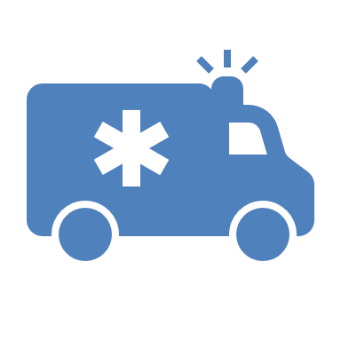
CONCEPT:EMS
EMS providers that are transporting critically unstable patients to a STEMI, Stroke, or Trauma Center but need to stop at the closest receiving hospital for life saving critical interventions before continuing on to a specialty care center.
Notes:
Don’t forget to make Trauma, STEMI or Stroke Base Hospital Contact! Let them know you are coming so they can be ready!
Examples of critical interventions (but not limited to): intubation, blood products, tube thoracostomy

Slide 10

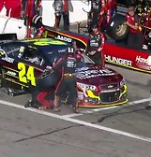
CONCEPT: EMS to Specialty Care Centers
  Is the patient’s condition unstable?
  If YES! PIT STOP at the closest receiving hospital.
  “Continue-on” the immediate life- threatening condition is resolved.
Notes:
In a Nascar race the most important is thing to get the driver to the finish line and it takes only to seconds to fuel and change tires. For EMS, when TIME IS OF THE ESSENCE a pit stop @ RH to resolve the life threatening condition may be warranted. The goal is to stabilize as quickly as possible and CONTINUE on to SCC. “Unstable” is subjective and relies on the clinical skills of the EMS care team, a teaching point- more specific wording that describes a patient that cannot be managed safely to a further facility.

Slide 11
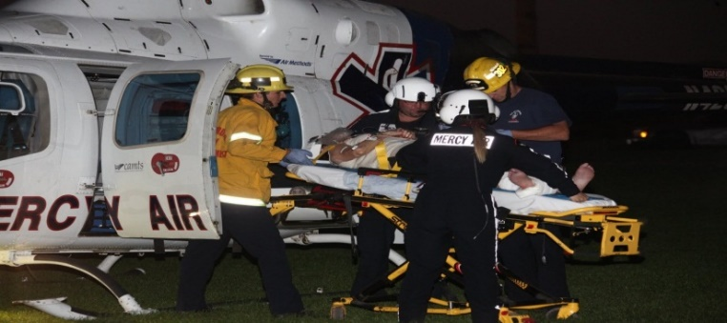
CONCEPT: EMS
Make Base Station contact
  Let them know that you are coming their way but will be pit stopping for patient stabilization.
  Don’t forget to let the receiving hospital know too!
Helicopter transport should be used if ground transport is expected to be >30 minutes
Notes:
Don’t forget to make Trauma, STEMI or Stroke Base Hospital Contact! Let them know you are coming so they can be ready!
Examples of critical interventions (but not limited to): intubation, blood products, tube thoracostomy

Slide 12
CONCEPTS: Referral Hospital
EKG consistent with STEMI | STEMI Center
Meets trauma triage criteria | Trauma Center
Positive mLAPSS | Stroke Center
Identified LVO at Stroke Center | Higher level of care Stroke Center
Traumatic injuries at Trauma Center requiring higher level of care | Higher level of care Trauma Center (Ex: cardiothoracic surgery)
The referral hospital recognizes a critically injured patient that requires urgent transfer to a specialty care center:

Slide 13
CONCEPTS: Referral Hospital to Specialty Care Center
Does the patient meet trauma triage criteria as per ICEMA policy
If YES! Perform only life sustaining measures, e.g., airway stabilization, massive bleeding control etc
Do not delay transfer for any unnecessary diagnostic procedures!
Think… If I get these tests, do I have the resources to provide an intervention? If not, do not delay…use Continuation of Care

Slide 14
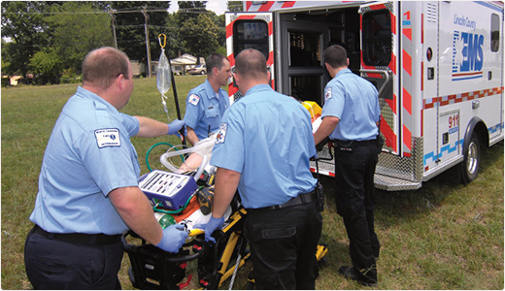
INITIAL TREATMENT GOALS
AT REFERRAL HOSPITALS
Initiate resuscitative measure within the capability of the facility
Ensure patient stabilization is adequate for subsequent transport
GOAL: Transfer time <30 minutes (door-in to door out)
DO NOT Initiate unnecessary diagnostic procedures

Slide 15
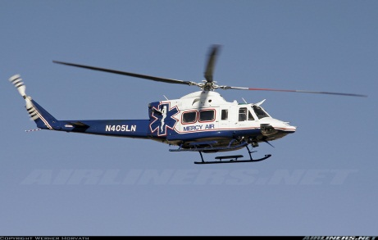
TRANSFER PROCEDURE
REFERRAL HOSPITAL
The Referral hospital ED Physician will make a direct call to the ED physician @Specialty Care center
The Referral ED Physician will determine if ground or air transport is necessary. If ground transport is > 30 minutes then air transport may be utilized

Slide 16
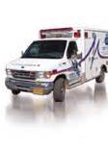
TRANSFER PROCEDURE
SPECIALTY CARE CENTER
The Specialty Care Center ED Physician will accept the trauma, STEMI, or Stroke patient (unless on internal disaster ICEMA policy # 8060)
The ED Physician is the accepting physician at the Specialty Care Center. The receiving center will activate its internal Trauma Stroke or STEMI team according to their internal policy

Slide 17
TRANSFER PROCEDURE CONT’D
SIMULTANEOUSLY…
Call 9-1-1, using the following script:
  “This is a Continuation of [ Trauma, STEMI, Stroke] from XXXX Hospital to XXXX Hospital.”
  Dispatch will only send transporting ambulance without any fire apparatus
“DO NOT DELAY TRANSPORT” for documents. The referral may FAX all patients documents to the Receiving Hospital
  E.g., Medical record, labs, x-rays, H&P’s, reports and any other pertinent documentation.

Slide 18

SPECIAL CONSIDERATIONS
If the patient arrived at the referral hospital by EMS the referral hospital ED Physician may request transport unit to remain with patient for minimal stabilization and transport immediately to the appropriate Specialty Care Center.
The referral hospital may consider sending a Physician or Nurse with transport unit if deemed necessary due to patient condition or scope of practice
Notes:
If the referral hospital wishes to request CCT transport do not call 911 dispatch they must call the transport agency/provider dispatch center directly and this transfer falls out of the Continuation of Care criteria.

Slide 19


TEST YOUR KNOWLEDGE #1
75 year old patient, is brought into your community hospital with a family member with a deformed lower leg from a standing level, trip and fall. This patient states he did not hit his head, recalls the incident . GSC 15, AOX4, VS: BP 127/89; HR 102; RR 18; Pulse ox 100% on Room Air.
Is this a Continuation of Care patient?

Slide 20
TEST YOUR KNOWLEDGE #1
ANSWER:
No.
This is not a Continuation of Care patient. This patient did NOT meet Trauma Triage Criteria.

Slide 21
TEST YOUR KNOWLEDGE #2
I have made contact with the nearest paramedic receiving hospital that I am coming in with a STEMI patient with CPR in progress. I need an airway and the closest SCC is 20 minutes away.
The airway was stabilized at a RH and now I am en route to the SCC.
What is the best next step?

Slide 22
TEST YOUR KNOWLEDGE #2
ANSWER:
Make SCC Base Contact
Do not assume that the RH has made contact with the Specialty Care Center. Call the appropriate Specialty Care Center and give a brief update and ETA.

Slide 23
TEST YOUR KNOWLEDGE #3
35 y.o high speed MVA, off the I-40 multiple traumatic injuries, with GCS of 13. Co-occupant death.
Airship has been called, but with a delayed ETA.
The patient’s condition is deteriorating. She is becoming increasingly agitated, and the VS are becoming increasingly unstable.
The closest trauma center is 1 hour 30 away by ground ambulance. The closest paramedic receiving center is 35 minutes away.
What would you do?

Slide 24
TEST YOUR KNOWLEDGE #3
ANSWER:
EMS: Do not delay on scene. Place patient in the ground ambulance and proceed to the closest paramedic receiving center.
Make Trauma Base Hospital contact.
Consider re-contacting airship to rendezvous at the RH for subsequent transport to the trauma center.
RH: Stabilize the patient. Secure airway, control bleeding. Do not delay transport to obtain labs, XR’s or scans. Contact SCC ED physician and call 9-1-1 “for Continuation”, or coordinate with airship that may have already been called by EMS on-scene.

Slide 25
QUESTIONS?
Thank You

Slide 26
REFERENCE PROTOCOLS
# 9010 Continuation of Care
#9030 Destination
#9040 Trauma Triage Criteria
#14230 Suspected Acute Myocardial Infarction
#14080 Stroke Treatment-Adult
#14090 Trauma – Adult
#14180 Trauma – Pediatric
Authority:-
California Health and Safety code,
Division 2.5, 1797.204
California Code of Regulation, Title 22

Slide 27

Acknowledgements
Thank you to Dr. Alayna Prest, Dr. Michael Downes, Joy Peters, & Shawn Reynolds, for your contributions to this project.

Slide 28


ICEMA Continuing Education (CE) Information
This course meets criteria for one (1) ICEMA Pre-Approved Core Course
ICEMA
Approved
EMS Continuing Education Hours (CEH)
This course has been approved for up to two (2) EMS Continuing Education hours (CEH) when administered by an approved California EMS CE Provider.
BRN Continuing Education
This course has been approved for up to (2) Continuing Education hours (CEH) when administered by an approved California EMS Provider.
Notes:
Remember to send your CEU/CE Rosters to ICEMA.

